Slide 1
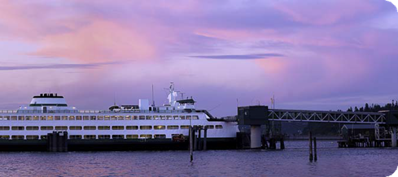
Ferry Fairy!
Upgraded User Interface for Ferry System

Slide 2
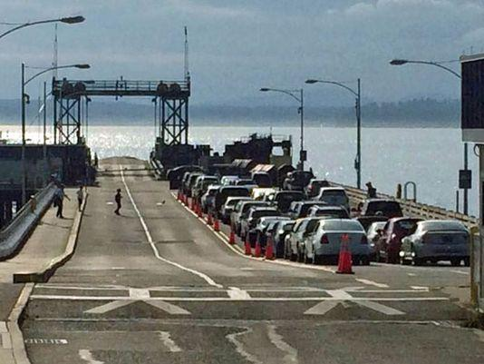
Problem
Fauntleroy traffic congestion around ferry
King5 News
#missedtheboat

Slide 3
Solution
We have a better travel experience when we know what to expect
2 User Types Identified
Commuter
Casual User

Slide 4
Benefits
Commuter knows what to expect
Future Benefits
WSDOT increased ridership
Collection of valuable data set
Potential redistribution of traffic load
Wait Time Shortened

Slide 5
Ferry Fairy Demo

Slide 6
Impact of Ferry Fairy
23 million users have better knowledge!
Better travel experience by knowing what to expect
ONE location for information from multiple sources
Data Collection to replace historical data
Users can adapt their travel plans – Redistribute traffic load

Slide 7
Show Me the Money
Start with volunteer
As Usership grows, more data – Bigger dataset becomes more valuable

Slide 8
Next Steps
Adding routes
Currently only Edmonds / Kingston
Word of Mouth / Distribution
Expand Realtime Solution
Upstream of the Toll Booth
Vehicle Detection Loop
WSDOT Toll Booth data
Utilization of User GPS Data / Landmark Data
Parking Space Information
Notes:
Shout outs / thanks - include Lisa Ballard

Slide 9
Thanks!
MOZ, Socrata, Microsoft, Amazon WS, Google, GA, Wework and lots of other partners
All the Mentors’ & Volunteers
Lisa Ballard & WSDOT Ferries
coffee, sommeliers, & cookies
and of course….. Ferries. Or fairies?

Slide 10
